Slide 1
EGS PILLAY ENGINEERING COLLEGE
NAGAPATTINAM,(AUTONOMOUS)
TOPIC : PUBLIC SPEAKING
NAME : PRITHIVIRAJ T
REG.NO : 8208E22BSR043
CLASS : 3RD YEAR CSBS
SUBJECT : BCVS – 4
DATE : 03/07/2025

Slide 2

The Legacy of Jacinda Ardern: A Global Leader
This presentation explores the remarkable political journey and profound global impact of Jacinda Ardern, New Zealand's former Prime Minister.

Slide 3
A Journey into Politics
1980
1
Born in Hamilton, New Zealand
2
2008
Elected to Parliament
2017
3
Became Leader of Labour Party
4
2017
Prime Minister of New Zealand
2023
5
Resigned from Office

Slide 4

Key Achievements & Milestones
Youngest Female Head of Government
A pioneering moment upon her election.
Labour Party Leadership
Guided the party to significant electoral success.
Progressive Policies
Championed social welfare and gender equality.

Slide 5

Compassionate Leadership in Crisis
Christchurch Mosque Shootings (2019)
COVID-19 Pandemic
Led New Zealand with a highly effective and transparent strategy, prioritising public health and well-being.
Her empathetic and decisive response earned global praise, fostering unity and implementing swift gun law reforms.

Slide 6
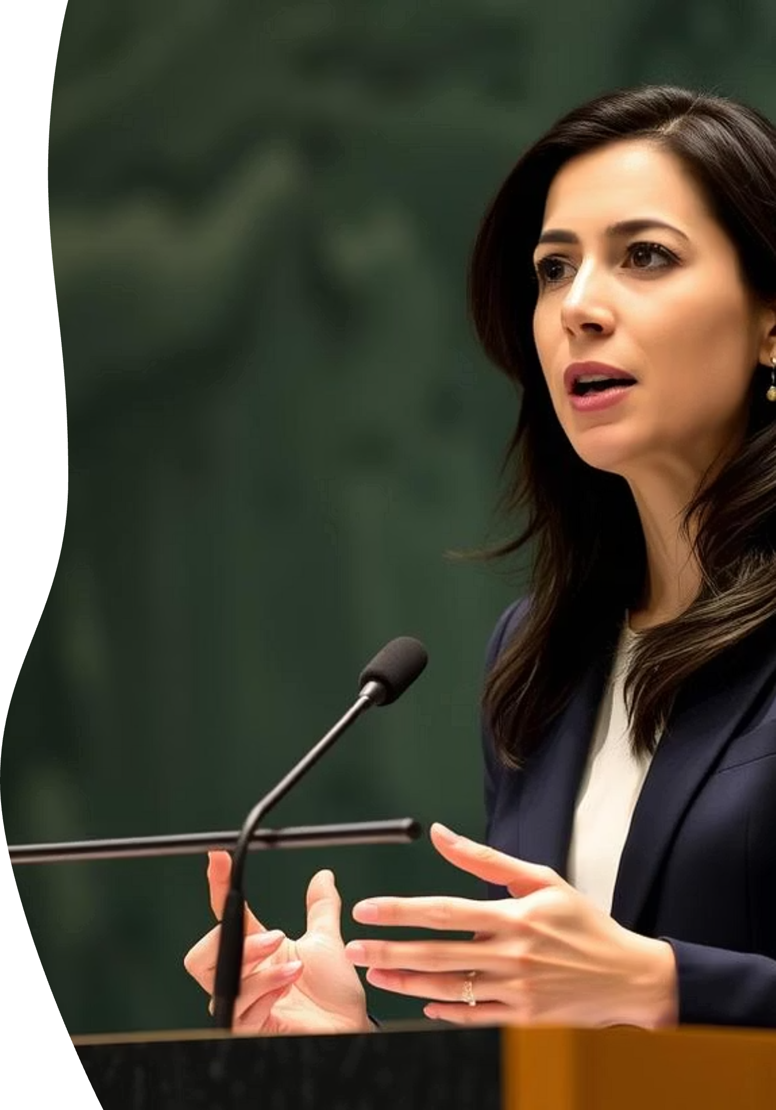



Global Political Influence
International Diplomacy
Climate Action Leadership
A strong advocate for multilateralism and global cooperation.
Pushed for ambitious climate policies on the world stage.
Champion for Gender Equality
Inspired women leaders worldwide with her unique style.

Slide 7

A Unique Approach to Governance
Empathy-Driven Policies
Inclusive Decision-Making
Focused on policies that genuinely served the well-being of all citizens.
Prioritised listening to diverse voices within New Zealand society.
Transparent Communication
Maintained open and honest dialogue with the public, building trust.

Slide 8
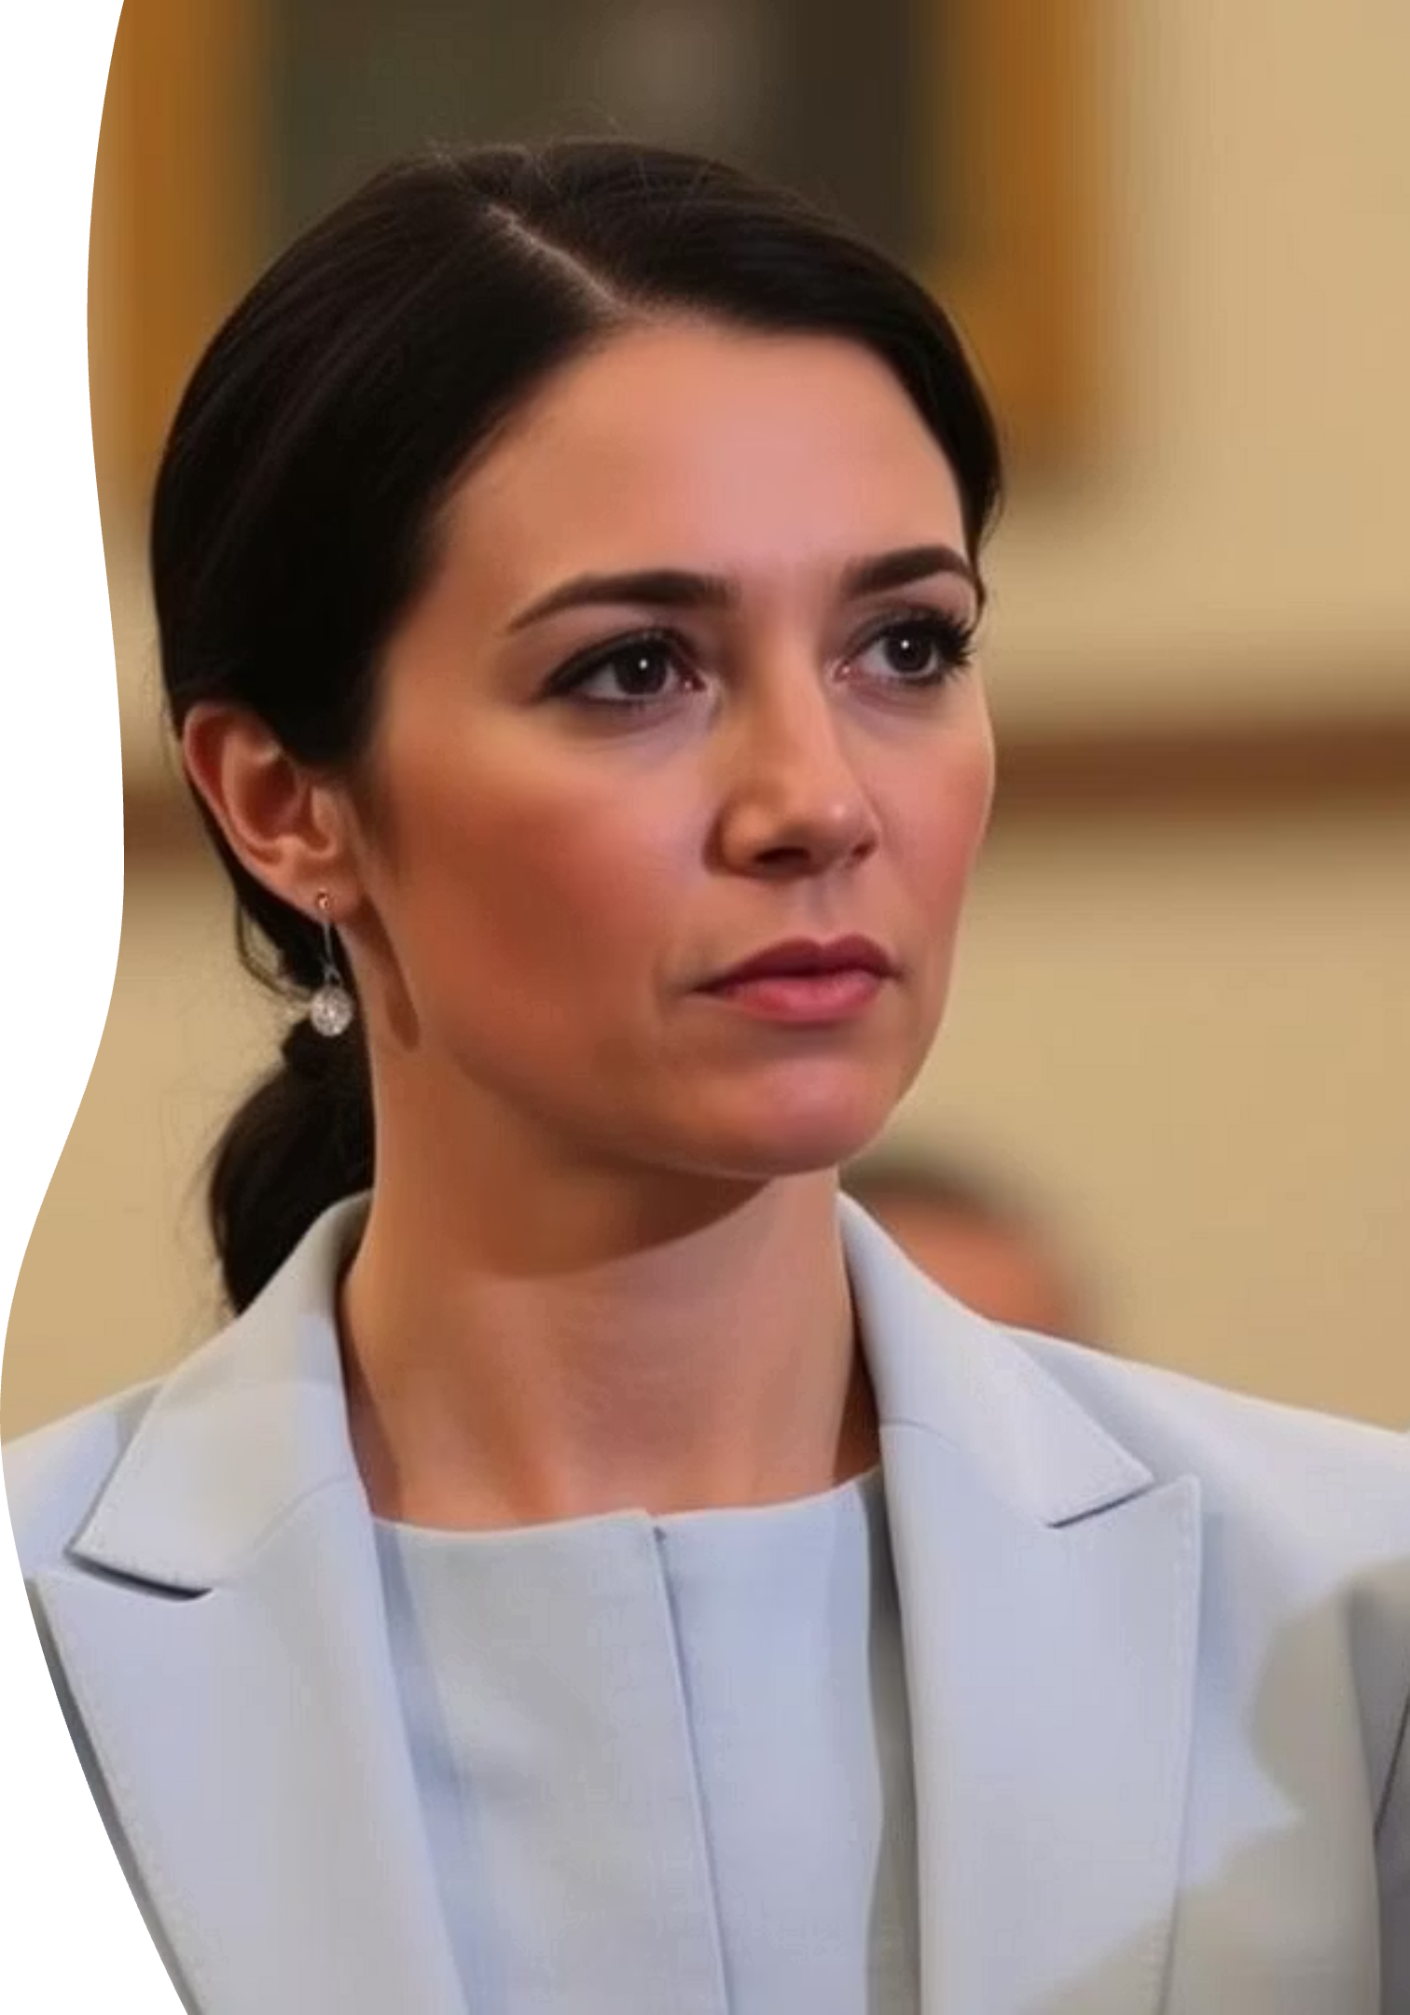
Jacinda Ardern's Enduring Legacy
Jacinda Ardern's tenure as Prime Minister redefined modern leadership, characterised by progressive ideals and a deep commitment to social justice.
Demonstrated the power of compassionate governance.
Set a new standard for crisis management with empathy and clarity.
Inspired a generation of leaders to prioritise well-being and inclusivity.

Slide 9

TRANSFORMATIVE GOVERNANCE
The Long-Term Impact of Ardern's Policies
1
Social Equity Initiatives
Ardern's government prioritised policies aimed at reducing child poverty and improving mental health services, leaving a measurable positive impact on New Zealand society.
2
Climate Change Leadership
Her administration enacted ambitious climate legislation, positioning New Zealand as a global leader in environmental stewardship and sustainable development.
3
Pandemic Response Model
Her decisive and empathetic handling of the COVID-19 pandemic garnered international praise, establishing a benchmark for public health crisis management.

Slide 10




FUTURE POTENTIAL
Ardern's Enduring Significance in Global Discourse
Policy Architect
Her experiences provide invaluable insights for future policy-making on global challenges.
Inspirational Figure
Ardern continues to inspire a new generation of leaders with her unique approach.
Global Advocate
Her voice will remain crucial in shaping international political and social change.

Slide 11

Thank You
Jacinda Ardern's contributions to New Zealand and international politics will continue to inspire for years to come. Her leadership philosophy offers valuable lessons for governance in an increasingly complex world.

